Slide 1
Heaven or Hell? Love the Shell!
Revisting the UNIX command line

Slide 2

Love the shell
A quick look under the hood
The environment and package managers
Cross-Platform compatibility?
A few more commands and tricks

Slide 3
Love the shell
Shell Configuration
Bash_profile - Configure your environment
cd ~/
‘edit .bash_profile’ or ‘more .bash_profile’
Bash_history
cd ~/
‘more .bash_history’

Slide 4
Walking down the path
A few shortcuts working in BASH
Tab – autocomplete
control+a – cursor to beginning of the line
control+e – cursor to end of line
Up/down arrow – scroll through history of commands
Drag a file or folder into shell to show path.
open . – open a directory in current location

Slide 5
Walking down the Path
$ echo $PATH
/Users/maxrose/anaconda/bin:/usr/local/bin:/usr/bin:/bin:/usr/sbin:/sbin:/opt/X11/bin:/usr/local/sbin:/Users/maxrose/shellscripts
/Users/maxrose/anaconda/bin – Familiar?
/usr/local/bin
/usr/bin
/bin
/usr/sbin
/sbin
/opt/X11/bin
/usr/local/sbin
/Users/maxrose/shellscripts – Custom addition

Slide 6
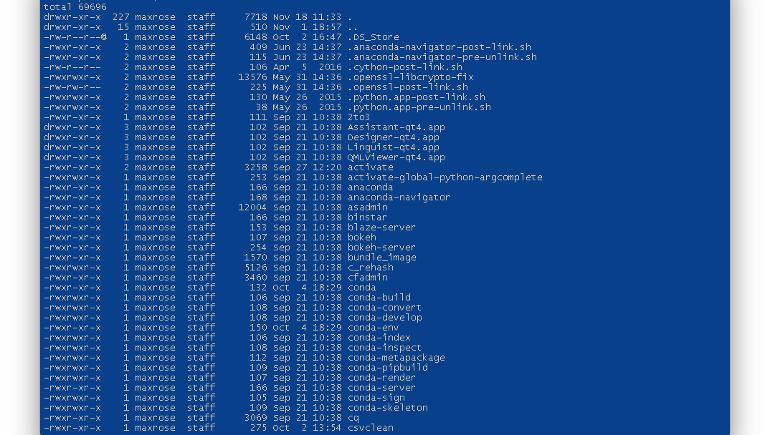
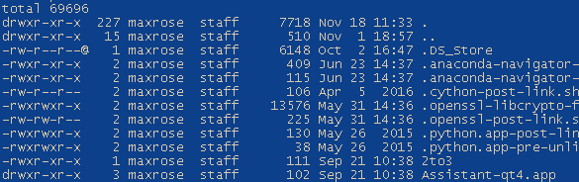
Walking down the path

Slide 7
Free Stuff!
Commands in the shell are really programs.
Endless programs can be found and installed.
Introducing the Package Manager
Apt-get - *nix
Homebrew – Mac
Pacman – Git for Windows
BASH in Windows
http://www.hanselman.com/blog/DevelopersCanRunBashShellAndUsermodeUbuntuLinuxBinariesOnWindows10

Slide 8
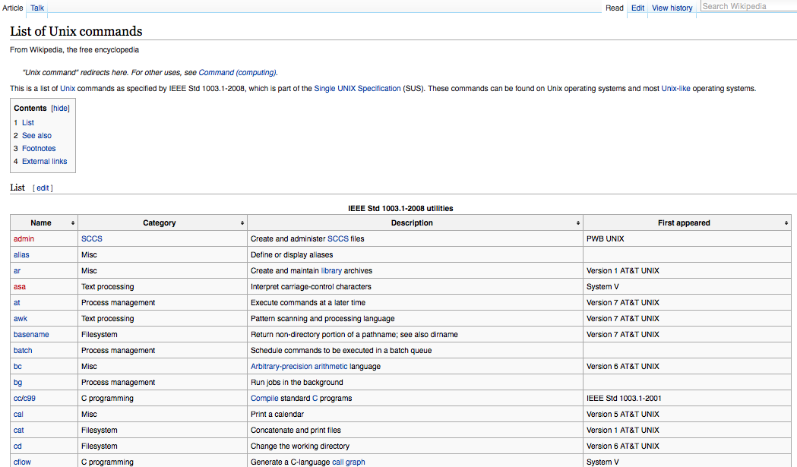
Free Stuff!

Slide 9
Free Stuff!
Installation and Dependencies
‘brew install ffmpeg’ – It’s that easy!
RTFM!
ffmpeg –h or ffmpeg –help or ffmpeg -?
man ffmpeg
man ls

Slide 10
AWKward Moments or that’s what he sed
A few more useful commands
tr – simple string replacment , ‘squeeze’ characters
sed – complex text manipulation, regular expressions
awk – parse/display structured text
curl – interact with the internet on the command line
chmod - modify file permissions
chown - change file ownership
cat – concatenate similar files to single file

Slide 11
AWKward Moments or that’s what he sed
CURL
curl 'https://github.com/g-v a-students/DS-SEA-4'
curl -I 'https://github.com/g-v a-students/DS-SEA-4
AWK
cd ~/
ls -la | awk '{print $5 "\t" $6 " " $7 " " $9}'
TR
str="this is a poor ex@mple"
echo $str | tr -s ' ' | tr '@' 'a'
SED
echo $str | sed 's/ / /g;s/@/a/g;'

Slide 12
Resources
Homebrew / Apt-get / pacman
http://brew.sh
https://help.ubuntu.com/community/AptGet/Howto
https://github.com/git-for-windows/git/wiki/Package-management
BASH in Windows
http://www.hanselman.com/blog/DevelopersCanRunBashShellAndUsermodeUbuntuLinuxBinariesOnWindows10.aspx
http://www.howtogeek.com/249966/how-to-install-and-use-the-linux-bash-shell-on-windows-10/

Slide 13
Resources
CURL http://www.makeuseof.com/tag/get-curly-10-useful-things-can-curl/
SED
http://www.theunixschool.com/2013/02/sed-examples-replace-delete-print-lines-csv-files.html
AWK
http://www.funtoo.org/Awk_by_Example,_Part_1
TR
http://www.thegeekstuff.com/2012/12/linux-tr-command/

